Slide 1
Design And Analysis of Algorithms
Isomorphism in biological networks
BY:
N.Sowgna-2010030344
E.Pravallika-2010030046
Tahseen Begum-2010030168
Keerthana-2010030445
Under the guidance of
P. Sree Lakshmi

Slide 2
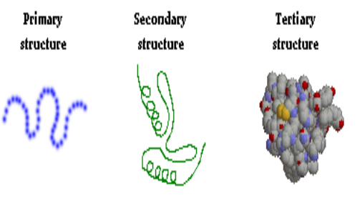
Problem Statement
Graph Isomorphism Is Widely Used In Various Applications Such As Image Processing, Protein Structure, Computer And Information System, Chemical Bond Structure, Social Networks.
We Use Protein Structure ,Nodes Represents Protein And Edges Represents Their Interactions Between Nodes.
We Have Three Levels Of Protein Structure I.E. , Primary Structure ,Secondary Structure , Tertiary Structure.
For Example Collection Of Food Is Available And Every Food Is Having Their Own Structure That Is Graph Structure. For Providing The Food And That Food Contains Some Proteins, Then Find Protein Graph Structure First And Check Where It Is Available In The Food Structure Or Not.

Slide 3
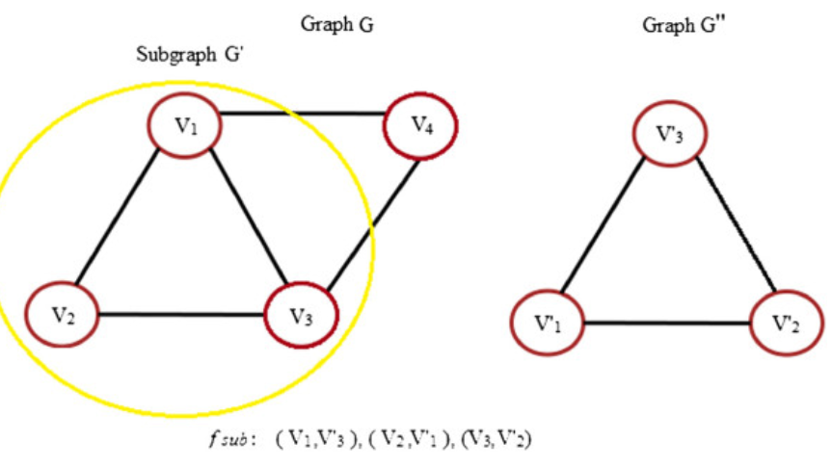
Existing solutions/ Naive solutions
A graph G1 = (V1, E1) is isomorphic to a subgraph of a graph G2 = (V2, E2) if there exists a subgraph of G2, say G2a, such that G1 =~ G2a
Assume G1 has n nodes.
Lets examine each subset of G2 that has n nodes, check if they have the same labels as nodes in G1,and if yes, check if the edge in G1 exists also in the selected set.
we get an exponential algorithm

Slide 4
Proposed Algorithm Design Technique
We have two types of algorithm i.e., Ullmann Algorithm,VF2 Algorithm but we went across VF2 Algorithm.
VF2 starts with the first vertex and selects a vertex connected from the already matched query vertices.
The VF2 Algorithm is a matching graphs or directed graphs in a predetermined manner. Hence Used for Checking isomorphism in two chemical compounds
It Returns Boolean if given two graphs are isomorphic or not.

Slide 5
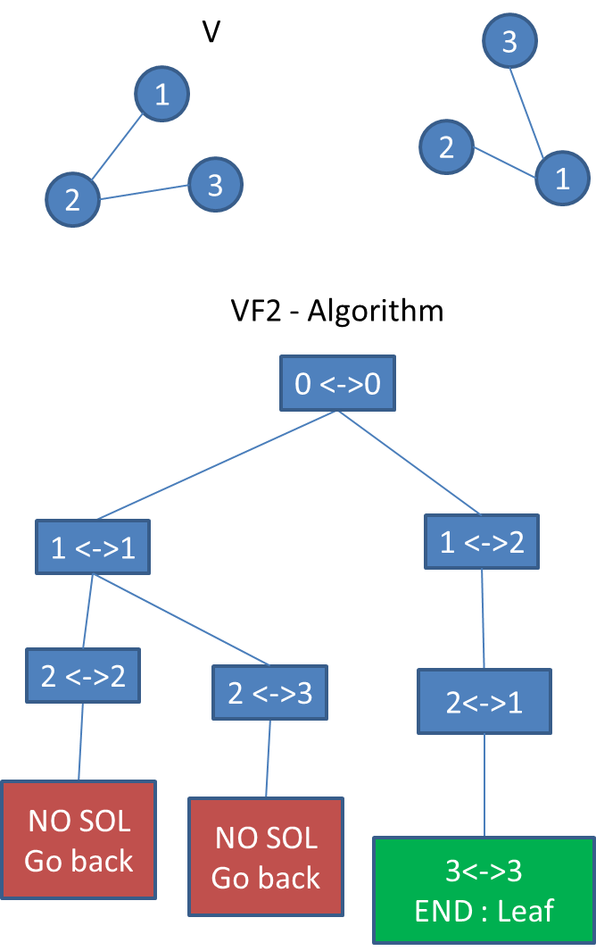
step 1 :
I match empty V with empty V' : it always works
step 2 : I can match 1V with 1V',2V' or 3V'
I match 1V with 1V' : it always works
step 3 :
I can match 2V with 2V' or 3V'
I match 2V with 2V' : it works because {1V 2V} and {1V' 2V} are isomorphic
step 4 :
I try to match 3V with a node in V' : I cannot! {it would be possible if there were an edge between node 3 and 2 in V', and no edge between 3 and 1)
So I go back to step 2

Slide 6
step 5:
I match 2V with 3V'
step 6:
same as step 4
I go back to step 2. there is no solution in step 2 , I go back to step 1
step 7:
I match 1V with 2V'
step 8:
I match 2V with 1V'
step 9 :
I match 3V with 3V'
it works I matched {1V 2V 3V} with { 2V' 1V' 3V'}
The graphs are isomorphic

Slide 7
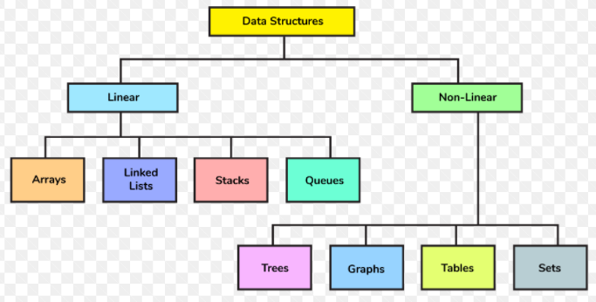
Data Structures needed
We Use Graphs For Our Project As A Data Structure.
Graphs Are Powerful Data Structure To Represent Objects And Their Concept.
Objects Are Nothing But Nodes And Edges Describes Relation Among Object
Graphs Are Remains Same If And Only If We Are Not Changing Their Label.

Slide 8

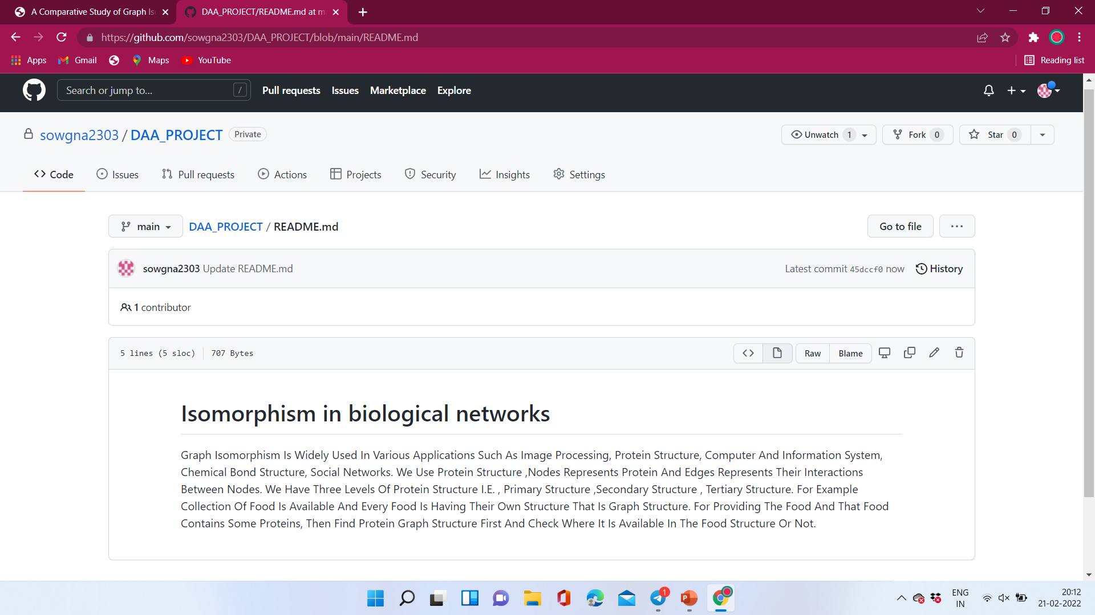
GitHub setup
Link: https://github.com/sowgna2303/DAA_PROJECT

Slide 9
Division of work among the group members
N. Sowgna- Github setup, Data Structures needed, ppt
E. Pravallika -Problem statement and domain
Keerthana -Existing solutions/ Naïve solutions
Tahseen Begum-Proposed Algorithm Design Technique

Slide 10

THANK YOU

